Slide 1
Placemat and Licensing Guide
For External Use

Slide 2
Microsoft External Public
Title | Agent 365 Placemat and Licensing Guide (External Public)
Audience | For use external to Microsoft, no NDA required
Purpose | Provides guidance to support Agent 365 licensing conversations Clarifies current Agent 365 features and business model Helps answer questions on Agent 365 value within the context of other Microsoft Cloud subscriptions
Version | Last updated May 2026

Slide 3
Contents
Core licensing concepts for A365
Agent 365 in the context of different service plans
A365 availability by agent type
Product-specific licensing clarifications
A365 Placemat
FAQ

Slide 4
Core licensing concepts for A365

Slide 5

Agent 365 is intended for every agent
“Every agent has a human boss”
Each agent is tied to a human. This includes agents with the following access models:
Delegated access – access is delegated from user to agent. The agent works on behalf of a human (aka known as OBO – on behalf of).
Own access – Agent operates with its own permissions, not bound to any user. It can work with people, acting like an AI teammate or operate a background process that doesn't have any interaction with people. Each such agent still requires human operational oversight that can be done by either agent's "manager" or "sponsor"
All users must be licensed for Agent 365
License is assigned to a user, not to an agent
$15 PUPM or via ME7 license, which includes one Agent 365 license^{(a)}
Transactable on May 1st.
Our focus today is here.
Question: Is there a difference between how agents with delegated and own access are licensed?
Answer: Both access models are licensed per user; every agent user/sponsor/manager should hold an Agent 365 license.
Note: (a) Agent 365 and ME7 licenses do not include agent licenses to productivity or collaboration tools (e.g., own email address, OneDrive storage, Word/Excel/PowerPoint/Outlook/Teams apps, and the use of other M365 services).

Slide 6
Agent 365 is licensed per-user for all agents
Per-User Licensing
Alignment with delegated access/own access scenarios: Agents either work on behalf of a user or has a person that plays a role as the agent’s sponsor/manager; licensing will be per user for both scenarios.
Cost control: Users can create and use agents with delegated access /own access scenarios without paying more for each agent.
Predictability: A per‑user model keeps costs stable as organizations experiment and refine how agents are used.
Question: If Agent 365 governs agents rather than people, why is it licensed per user for both delegated and own access agents?
Answer: Agent 365 is licensed per user because every agent has a human that is associated with it in some form or fashion. It’s a familiar and predictable model that helps customers plan and budget their adoption. A similar model exists today for Intune application management – for each licensed user, Intune manages all enterprise applications for such user.

Slide 7
An Agent 365 license is recommended for all users of A365 managed agents
Who should have an A365 license?
We recommend broad coverage, including:
Users, owners, sponsors, and managers of A365 managed agents (Agent that is in registry). For agents with delegated access, users who delegate their access to agents will need to be licensed with A365; for agents with own access, the sponsor or the manager will need to be licenses with A365.
Microsoft 365 Copilot users
Teams moving beyond pilots into broader agent adoption
Question: Who needs an Agent 365 license?
Answer: An Agent 365 license is recommended for all users who interact with, manage, or sponsor A365 managed agents
If asked: A license is required only for the users who interact, manage, or sponsor agents that use features of A365.

Slide 8
A365 licensing is contractually enforced – same as today for ME5
Contractual enforcement
1
2
3
If an agent is tied to an unlicensed user, the activity is not entitled to A365 protections. This creates an out of compliance scenario.
Under Microsoft Universal License Terms, users cannot compliantly access functionality they are not licensed for
Multiplexing (pooling services to reduce the number of required licenses) is not permitted
Question: What is the difference between licensed and unlicensed users in the context of Agent 365?
Answer: When an agent is used, sponsored, or managed by a licensed user, the resulting activity is fully observed, governed, and secured by Agent 365. If an agent is used by an unlicensed user, the activity is not entitled to Agent 365 protections.

Slide 9
ME5 enables discovery and basic action to manage local agents; A365 enables risk-based controls to manage local agents at scale
A365 for local agents (e.g., OpenClaw, Claude Code, etc.)
Discovery of endpoint agents: ME5
Coarse grain controls to block select endpoint agents (OpenClaw) : ME5
Adv. management, runtime protection, and blocking of endpoint agents : A365 paid Eg: Advanced runtime protection – detect an unmanaged local agent is attempting suspicious actions across files, commands, or credentials, block the risky behavior on the device, send an alert in the cloud, and create an XDR alert for investigation also visible in A365
Question: What licenses are needed for observability, security, and governance of local agents, such as OpenClaw, ClaudCode, etc?
Answer: For discovery and coarse-grained actions ME5 (Defender and Intune); for advanced security Agent 365.

Slide 10
Agent 365 in the context of different service plans

Slide 11
Agent 365 extends ME5 security and governance capabilities to agents at scale
Agents | Ecosystem partner agents via Agent 365 SDK
 | Foundry agents
 | Copilot Studio agents
 | Microsoft 365 agents*
Microsoft 365 Copilot
Users
Observability, Governance
Security
Identity & access control
Data security & compliance (for all interactions)
Threat protection
Data security & compliance for A2H** interactions
Secure it all
Secure M365 Copilot
Comprehensive security
Identity + access control
Data Security
Threat Protection
*Agents built with Agent Builder, SharePoint Agent, and Copilot Studio agents published in M365
**Agent-to-human and human-to-agent interactions
ME5 + Entra Suite
Agent 365
ME7
Question: I am already an ME5 customer, what additional value do I get from Agent 365 and/or ME7?
Answer: ME5 secures people and data. Agent 365 extends that foundation to govern, observe and manage all agents at scale. With Microsoft 365 E7, customers can comprehensively protect people, agents, and data.

Slide 12
A365 unlocks the full value to secure & govern agents at scale; ME5 only provides partial value for M365 agents
 | Agent type | Purview – data security & compliance |  | Defender – threat protection | Entra – identity and access management* | MAC – observability and governance
 |  | Agent-to-human | Agent-to-tools, agent-to-agent
Microsoft 365 agents | Agent builder agents | ME5 or A365 | A365 | A365 | A365* | A365
 | SharePoint agents | ME5 or A365 | A365 | A365 | A365* | A365
 | Copilot Studio agents published in M365 | ME5 or A365 | A365 | A365 | A365* | A365
Copilot Studio / Foundry | Copilot Studio agents not published in M365 | A365 | A365 | A365 | A365* | A365
 | Foundry agents | A365 | A365 | A365 | A365* | A365
Ecosystem partners | Partner ecosystem agents via Agent 365 & Purview SDK | A365 | A365 | A365 | A365* | A365
*Dependent on user having Entra P1 or Microsoft 365 E3 to support conditional access for agents that work on behalf of users
*Dependent on user having Entra P2, Microsoft 365 E5, or Entra Suite to support Identity Protection for agents that work on behalf of users
Question: I am already an ME5 customer, what additional value do I get from Agent 365 and/or ME7?
Answer: A365 provides end-to-end observability, governance and security for agents at scale. ME5 includes partial data security & compliance capabilities for agents that preceded Agent 365/ME7. We recommend all new customers adopt Agent 365/ME7 for comprehensive agent management.

Slide 13
A365 availability by agent type

Slide 14
Agent 365 covers both 1P and 3P agents
Full coverage*
Partial coverage
Microsoft-Built (1P) agents
Microsoft 365 Copilot
Agent builder
SharePoint
Copilot Studio
Foundry
Ecosystem Partner (3P) agents
Integrated with Agent 365 SDKs
Partial coverage for agents discovered in connected platforms (e.g. VertexAI, Bedrock, Agentforce, etc.)
Coverage will be dependent on platform and may include visibility into agent metadata or basic actions such as blocking or deleting.
More details to come as we get closer to GA of this capability (expected in July).
Question: What agents are currently covered by Agent 365?
Answer: Agent 365 covers both Microsoft-built and ecosystem partner agents integrated with the Agent 365 SDK.
*Full coverage planned for end of CY2026; See NDA Roadmap deck for current coverage of each agent type

Slide 15
Product-specific licensing clarifications

Slide 16
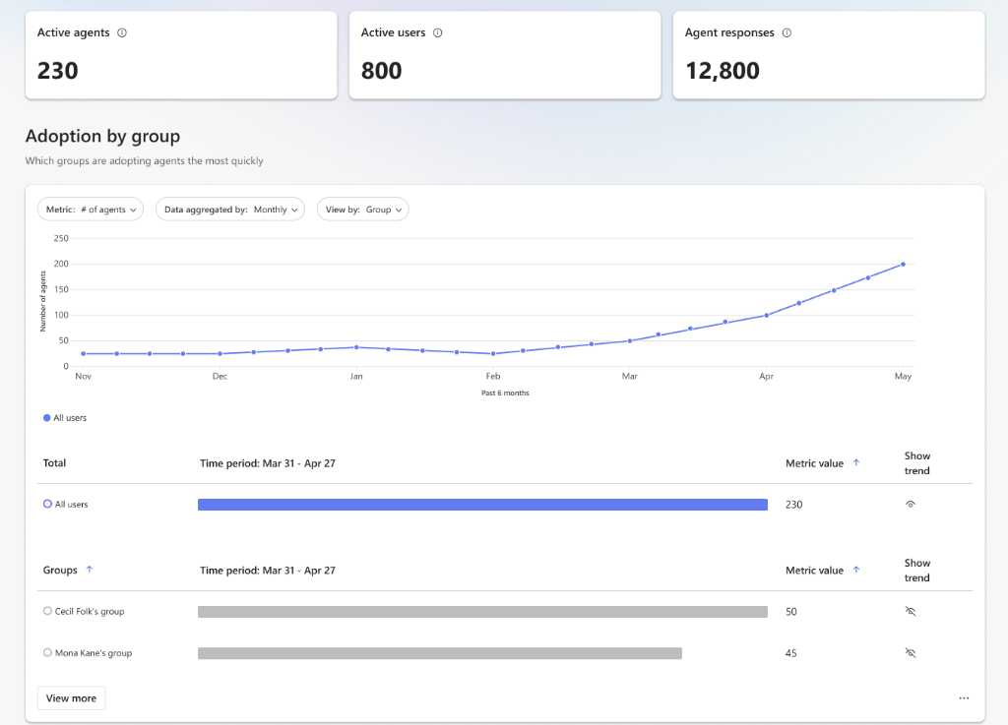
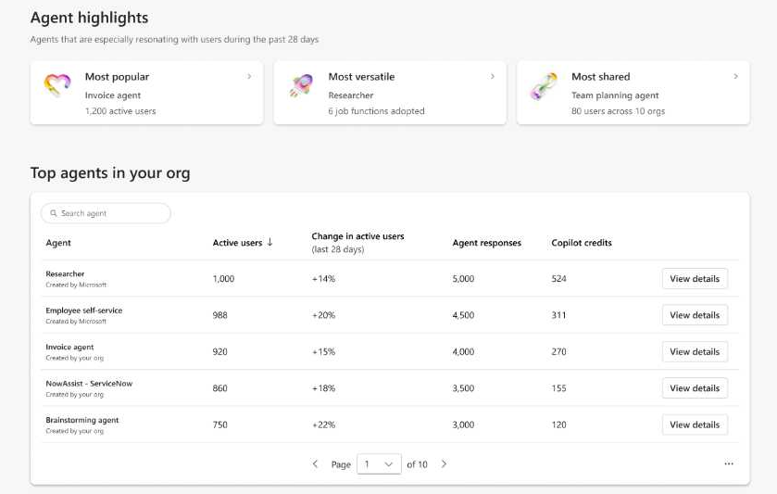
Agent Dashboard is a premium feature
Current state: Agent Dashboard from Viva Insights is currently in public preview and requires 50+ M365 Copilot licenses. Limited to agents that appear in Copilot.
End state: Will support Agent 365 telemetry and continue to be a premium feature. Timing for General Availability to be announced.

Slide 17
Defender for agents will be delivered via PUPM licenses through A365
Before the new A365 PUPM license,
Foundry agents were protected with Defender for AI PAYG and DCSPM meters (free in public preview for customers).
Copilot Studio agents were protected with MDA PUPM license (in public preview, licensing is subject to changes).
With A365, Defender licensing will be updated by workloads as below:
AI agents: delivered via PUPM licenses through A365, regardless of the AI platforms
Non‑agent workloads & AI infra: Continues via DCSPM & Defender for AI Services (PAYG)

Slide 18
A365 Placemat

Slide 19
Agent 365 Placemat (1 of 2) A365 provides enterprises observability, security, and governance for AI agents
Value pillar | Product Surface | Feature Name | Feature Description | Included with Microsoft cloud subscription¹ | Agent 365 $15 pupm
Observability | Entra | Agent Identity | Agent Identity² | • | •
 | Microsoft 365 admin center³ | Agent Registry | Visibility into rich agent metadata, permissions and access, security and compliance⁴ | • | •
 |  | Basic agent usage insights | Basic usage insights for agents used in M365 Copilot (active users and response count) in MAC agent usage report | • | •
 |  | Advanced agent usage insights | Advanced agent usage insights for all agents across Agent Registry, Agent Overview page, and Agent card |  | •
 |  | Agent Map | Visual representation of agent connections, usage, behavior, and relationships across the tenant |  | •
 |  | Registry sync | Synchronize agents and agent metadata from external platforms that aren’t managed by Agent 365 into the Agent 365 registry⁵ |  | •
 |  | Graph API | Graph API provides access to agent registry, basic metadata and governance actions. |  | •
Governance | Entra | Agent Identity Governance | Access packages for agents to define scope of agent permissions |  | •
 |  | Lifecycle management for agents | Built‑in Entra lifecycle policies automate sponsor‑driven workflows to maintain accountability |  | •
 | Microsoft 365 admin center³ | Admin agent governance actions | Admin agent governance actions (publish, deploy, block, delete, approve, assign agents to specific user/groups, reassign agent owner, pin, etc.) | • | •
 |  | Automate agent lifecycle actions | Automate agent lifecycle actions using conditions-based rules⁶ |  | •
 |  | Tool controls for agents | Control which tools (including Microsoft MCP servers) agents can access tenant-wide |  | •
 |  | Policy templates for agents | Policy templates to apply consistent security and compliance controls to agents |  | •
 | Purview | Audit logs and eDiscovery for agent activity | Audit logs of agent activities and eDiscovery (content search)⁷ of agent interaction to export and hold for legal, regulatory and investigative needs | • | •
 |  | Data Lifecyle Management for agent data and interactions | Data Lifecyle Management for agent generated data and interactions in line with regulations and org policies |  | •
 |  | Communication Compliance for agents | Detect and review non-compliant agent interactions, extend compliance manager to agents to assess, manage, and demonstrate AI compliance |  | •
Included with Microsoft 365 and Azure subscription except for where noted, Microsoft 365 E5 required.
Agent ID is a feature of the Entra platform and is needed for policies, governance, and security protection including ATG configuration.
Available for agents with delegated access and agents with their own access operating behind the scenes. Please refer to the Microsoft 365 public roadmap for GA timeline for agents with their own access and that participate in team workflows.
Unified Agent Registry powers agent inventories in Defender, Purview
Currently in public preview and will be included in the existing A365 license. Refer to the Microsoft 365 public roadmap for the GA timeline
Bulk reassignment of ownerless agents built in Agent Builder and bulk deployment of Microsoft-built agents available as of May 1. Additional standard rules and customizable rules to follow.
Only content search is included with Microsoft Cloud subscription. Post discovery data export and hold is charged to the customer
Using network capabilities inclusive of threat intelligence filtering, Web and URL filtering, prompt injection protection, and network file filtering
Applicable to agents running on Entra registered devices with a Global Secure Access client installed.
Discovery and blocking of unsanctioned local agents on endpoints are included in Microsoft 365 E5 and E7 subscriptions, and for customers that have deployed Microsoft Defender for Endpoint and Intune, it can be managed through the Agent 365 experience in Microsoft 365 Admin Center or through Defender and Intune portals.
Features expected to be in public preview in June.
Defender features listed here are currently in public preview and will be included in the existing A365 license. Please refer to the Microsoft 365 public roadmap for the GA timeline.
Defender Threat Investigation and Hunting will require a user to be licensed for Microsoft Defender for Cloud Apps.
Also requires Windows 365 for Agents.

Slide 20
Agent 365 Placemat (2 of 2) A365 provides enterprises observability, security, and governance for AI agents
Value pillar | Product Surface | Feature Name | Feature Description | Included with Microsoft cloud subscription¹ | Agent 365 $15 pupm
Security | Purview | Data Security Posture Management for agents | Data Security Posture Management with AI Observability provides deep interaction visibility for Agents |  | •
 |  | Insider Risk Management for agents | Extend Insider Risk Management to agents – detect anomalous and risky agent activities |  | •
 |  | Agents inherit and honor data sensitivity labels | Agents inherit and honor data sensitivity labels |  | •
 |  | Data loss prevention for agents | Data loss prevention: block agents from accessing and sharing sensitive content |  | •
 | Entra | Conditional access and identity protection for agents | Conditional access and identity protection for agents (for agents with delegated access - extend user policies to agents) |  | •
 |  | Secure Access Service Edge (SASE) for agents | Monitor and block malicious and non-compliant network traffic⁸ for agents, operating on user devices⁹ and Copilot Studio agents |  | •
 | Intune | Device compliance for agent conditional access | Policy to require device compliance for agents’ Entra Conditional Access protection |  | •
 |  | Policy controlled environment for agents runtime | Automatic Intune enrollment for Windows 365 for Agent endpoints for continuous policy configuration and enforcement |  | •
 |  | Configure policies to contain managed local agents | Consent and execution controls enforced by the OS at an agent level, such as which files and networks each agent can access¹¹ |  | •
 |  | Block unsanctioned local endpoint agents | Block the most common ways OpenClaw runs on Windows managed devices with Intune policies^{10, 11} | ME5 & ME7 | ME5 & ME7
 | Defender | Discovery of AI on endpoints | Sync shadow AI endpoint agents, discovered by Microsoft Defender (available with MDE P2, ME5, or ME7 only)¹¹ | ME5 & ME7 | ME5 & ME7
 |  | Agent Security Posture Management | Identify and remediate agent misconfigurations and exposure risks, relationship mapping for local agents (agent to devices, MCPs, etc.)¹² |  | •
 |  | Threat Detection and Blocking for agents | Detect suspicious agent activity, receive alerts and allow blocking for tool invocations for agents¹² |  | •
 |  | Threat Hunting and Investigation for agents | Collect A365 unified agent observability logs and allows Investigation and hunting for threats in for agents^{12, 13} |  | •
Included with Microsoft 365 and Azure subscription except for where noted, Microsoft 365 E5 required.
Agent ID is a feature of the Entra platform and is needed for policies, governance, and security protection including ATG configuration.
Available for agents with delegated access and agents with their own access operating behind the scenes. Please refer to the Microsoft 365 public roadmap for GA timeline for agents with their own access and that participate in team workflows.
Unified Agent Registry powers agent inventories in Defender, Purview
Currently in public preview and will be included in the existing A365 license. Refer to the Microsoft 365 public roadmap for the GA timeline
Bulk reassignment of ownerless agents built in Agent Builder and bulk deployment of Microsoft-built agents available as of May 1. Additional standard rules and customizable rules to follow.
Only content search is included with Microsoft Cloud subscription. Post discovery data export and hold is charged to the customer
Using network capabilities inclusive of threat intelligence filtering, Web and URL filtering, prompt injection protection, and network file filtering
Applicable to agents running on Entra registered devices with a Global Secure Access client installed.
Discovery and blocking of unsanctioned local agents on endpoints are included in Microsoft 365 E5 and E7 subscriptions, and for customers that have deployed Microsoft Defender for Endpoint and Intune, it can be managed through the Agent 365 experience in Microsoft 365 Admin Center or through Defender and Intune portals.
Features expected to be in public preview in June.
Defender features listed here are currently in public preview and will be included in the existing A365 license. Please refer to the Microsoft 365 public roadmap for the GA timeline.
Defender Threat Investigation and Hunting will require a user to be licensed for Microsoft Defender for Cloud Apps.
Also requires Windows 365 for Agents.

Slide 21
Appendix

Slide 22
Additional Resources
Agent 365 Licensing FAQs

Slide 23
Capabilities overview for ME5, Entra Suite, A365, and ME7
Product | Category | Core Capabilities | For Users |  | For Agents A365 | For Users + Agents ME7 | For others PAYG
 |  |  | ME5 | Entra Suite
Entra | Identity + Access Management | Identity platform | for Users | for Users | for Agents^{[1]} | For Users + Agents | N/A
 |  | Conditional Access
 |  | Privileged Identity Management
 |  | ID Protection
 |  | ID Governance
 | Secure Service Edge (Network) | Private Access
 |  | Internet Access (Web + AI Gateway)
Defender | Security Posture Mgmt. | Security Posture Management | For devices, identities, SaaS apps, and email^{[2]} |  | for Agents | For devices, identities, SaaS apps, email, and agents | For cloud infrastructure and non-agent AI workloads
 | Threat Protection | Threat Protection (Detection + Blocking + Hunting/Investigation)
Purview | Data Security | Data Security Posture Management | for M365 data + M365 Copilot interactions + agent-to-human interactions of M365 agents^{[4]} |  | for all agent interactions of all agents^{[3]} | For M365 data + M365 Copilot + Agent interactions | For non-M365 data + non-agent AI interactions
 |  | Information Protection
 |  | Data Loss Prevention
 |  | Insider Risk Management
 | Data Compliance | Audit & eDiscovery
 |  | Data Lifecycle Management
 |  | Communication Compliance
^{[1]} CA and ID protection for delegated access agents is evaluated against a user’s identity token, hence a user must be licensed with ME3 for CA and ME5 for IDP for these features to work for their delegated access agents
^{[2]} Security posture management and Workload protection for cloud infra / resources is not in ME5, but in the MDC PAYG SKUs
^{[3]} Label honoring, label inheritance, and label-based DLP require grounding data to be labelled. Manual labelling of M365 data OE3+, auto-labelling of M365 data ME5, auto-labelling of non-M365 data Purview PAYG
^{[4]} Agents built with Agent Builder, SharePoint Agent, and Copilot Studio agents published in M365

